Slide 1
THE #1 NAME IN B2B DEBT RECOVERY & RECEIVABLES MANAGEMENT FOR THE SOFTWARE, INTERNET, & TECHNOLOGY INDUSTRIES.

Slide 2
About panther, chase, & associates
Panther, Chase, & Associates was created with the key idea that collecting money can be done better, faster, & more efficiently. Since the mid-90’s, the company's founders had worked for some of the largest agencies in the country. They realized that there were certain industries that showed great promise, but their accounts were not being collected with as much success. This gap was due to the collectors not understanding this more sophisticated paper. The conventional methods of collecting debt in all of the other industries were not as effective when dealing with Software, Internet, & Tech. Panther, Chase, & Associates found the key to this problem by taking the time to find & hire seasoned collectors with backgrounds within those industries, then trained them how to become great collectors. This is the key to our 85.3% success rate.

Slide 3
#1 BENEFIT OF USING PANTHER, CHASE, & ASSOCIATES specialization & success rate
Panther, Chase, & Associates specializes primarily in the SOFTWARE, INTERNET, and TECHNOLOGY industries. Let’s face it, collecting in your industry is different than most industries. The invoice balances tend to be larger and with larger balances come more disputes. It takes a more sophisticated collector to collect on your more sophisticated paper.
Our specialization and experience in these industries has yielded an 85.3% success rate on large viable claims.

Slide 4
#2 benefit of using panther, chase, & assoc. face 2 face capabilities
PCA utilizes a nationwide network of 15,000 private investigators that can go out on site and talk to debtors at their office when demand letters and phone calls are not effective.
While other agencies are sending the same legal demand letters and getting screened out by voice mail repeatedly, we are talking to a decision maker at the debtor’s company face to face.
Why pay your current agency to duplicate your in-house efforts and leave money on the table. With this method, we are able to collect a higher percentage of accounts and return more money to our clients’ bottom line.

Slide 5
#3 benefit of using panther, chase, & assoc. Extensive background investigations
In order to collect the debt, we start by gaining an in-depth understanding of the company. Most agencies just call the debtor blindly.
We find out their annual revenues, how long they have been in business, & how the business is currently performing.
We will also investigate the principals of the company and their backgrounds.
We conduct asset searches, court searches, and news articles searches, as well as find out who else has granted them credit. Our collectors then create a strategy to collect the debt using informational & legal leverage.

Slide 6
#4 benefit of using panther, chase, & assoc. experienced, well educated, & compliant b2b collectors
Not only do our collectors come from the industries they collect on & have expertise in your type of debt, but PCA has an in house training & certification program that ensures they are kept up to date on all of the newest Federal laws having to do with B2B debt recovery. This gives our clients peace of mind that our collection methods remain professional and ethical.
Most of our collectors have advanced degrees and at least 10 years of experience in the industry.
We understand that your reputation is just as important as collecting your money. Our collectors are constantly being coached on how they can improve their efficiency and effectiveness. In our business you are either improving or going backwards each day.
We maintain a very high standard with weekly, monthly, & quarterly reviews. We always keep an eye out for our clients' best interests.

Slide 7
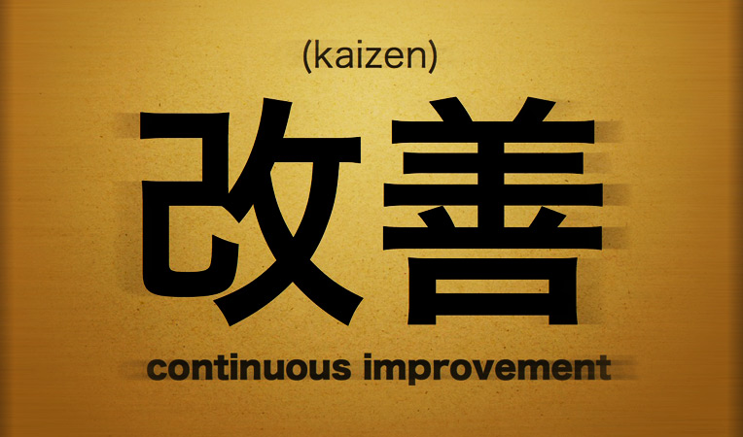
Creating a culture of continuous improvement
PCA instills in each team the Japanese business philosophy of Kaizen. By definition, Kaizen means change (kai) for the better (zen). The main idea of the philosophy is continuous improvement – there’s potential for improvement in just about everything.
Philosophy – The main idea behind Kaizen is that improvement should be everyone’s responsibility, whether they’re the C-suite or front line employees. Helping improve the organization should be both encouraged and rewarded.
Through this culture of C.A.N.I. or constant and never-ending improvement, we are able to maintain a high level of standards that most collection agencies could only dream of. Competition and bench marks keep our team collecting at a high rate. All of our employees work with the notion that they can always improve in some areas. This yields extraordinary results for our clients.

Slide 8
Varying degrees of collection approaches
In this day and age, client retention can be just as important as collecting your money. In addition to our hardcore collections for debtors who are refusing to pay, PCA offers a gentler approach for receivables that have simply grown quicker than a company's in house staff can keep up.
PCA has done dozens of multi-million dollar clean-ups for companies who did not have the manpower or resources to get it done quickly themselves. Many of our clients want to liquidate their past due receivables quickly without losing clients.
With our soft audit approach, the client is unaware they have been placed with a collections agency. Our collectors inform them they are just auditing some past due accounts in an effort to clean up your receivables. With this method the most important component is that the client relationship stays intact while still getting the money in.

Slide 9
B2b collection claim sizes
We handle claim sizes from $1,000 to $1,000,000. While our commercial collection agency takes claims of all sizes (average claim size must be $5,000 or more), we are recognized experts on large claims. When you are owed $25,000, $50,000, $200,000 or over $1 million, it typically is not a basic collection matter. And the amount owed to you is much more important to you than a smaller claim.
We are the recognized experts in large balance claims for software, internet, and tech related companies. Our collectors have collected millions of dollars over their careers and have the experience and expertise to collect your larger claims.​​

Slide 10
Payment plans
The larger the amount of the debt, the less likely the debtor will be able to make payment in full. In some cases it is necessary to grant the debtor a payment plan and then enforce that plan on monthly or weekly basis.
These plans are documented & agreed to in writing ahead of time and this can be preferable to not getting the money at all.
While we would prefer to get all of the money instantly, these client approved plans are usually preferable to litigation. ​

Slide 11
SETTLEMENT AGREEMENTS
From time to time a debtor may have a valid dispute with regards to the debt. In these cases a client may agree to accept less than the full amount to obtain a reasonable settlement.
In other cases, we may be competing with multiple other creditors that have placed the same debtor for collections.
If a company is towards the end of its life cycle, then it may be preferable to get a settlement before they go out of business. Of course, all settlements must be approved by our clients in writing prior to settling.

Slide 12
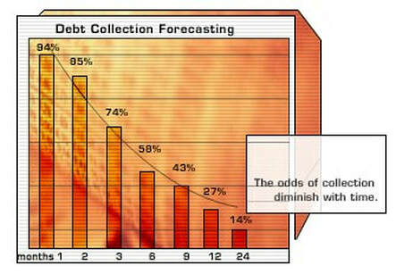
Collection trends what happens when there is a delay in placing accounts
Cash flow is the engine that drives businesses large and small. Delinquent accounts are the brakes that bring companies to a screeching halt. The economic exigencies of recent years has pushed many companies to extend the time they will permit an accounts receivable to age prior to instituting formal collection efforts.
Based on a survey of members of the Commercial Collection Agency Section of the Commercial Law League of America (CCAS) studying $8.4 Billion in accounts, and information supplied by the U.S. Department of Commerce, this "loosening" of payment requirements may be severely impacting on companies' cash flow and bottom line.
According to the survey results, the probability of full collection on a delinquent account drops dramatically with the length of delinquency. For example, even after only three months, the probability is that you will collect only 90¢ of each dollar delinquent. After six months, only 67¢ of every dollar will be collected or about 7 in 10 accounts, regardless of industry. We educate our clients on the proper time to place to improve collectability.

Slide 13
Panther, chase, & associates delivers results
At Panther, Chase, & Associates, we deliver results, it’s that simple.
We deliver customized solutions developed
based on your needs and deployed to
exceed your expectations.
Comprehensive Collections Programs for:
Software
Internet
Technology
Commercial Lending

Slide 14
Panther, Chase, & Associates delivers meaning to the phrase “ART & SCIENCE” as it applies to collection strategies
Panther Chase & Associates is utilizing the fundamentals of collections – not forgetting what is tried and true – all while embracing change and technology to optimize use of the tools we have developed and the tools that are at our disposal to deliver superior service to customers and clients today and into the future.
THE FUTURE OF COLLECTIONS IS NOW!

Slide 15
CONTACT PANTHER, CHASE, & ASSOCIATES
P.J. EVANGELISTA
NATIONAL SR. ACCOUNT EXECUTIVE
626-657-6050 X102
PJ@PANTHER-CHASE.COM
1055 E. COLORADO BLVD
5TH FLOOR
PASADENA, CA 91106
Additional Offices located in Silicon Valley and Silicon Alley.
www.Panther-Chase.com

